Slide 1
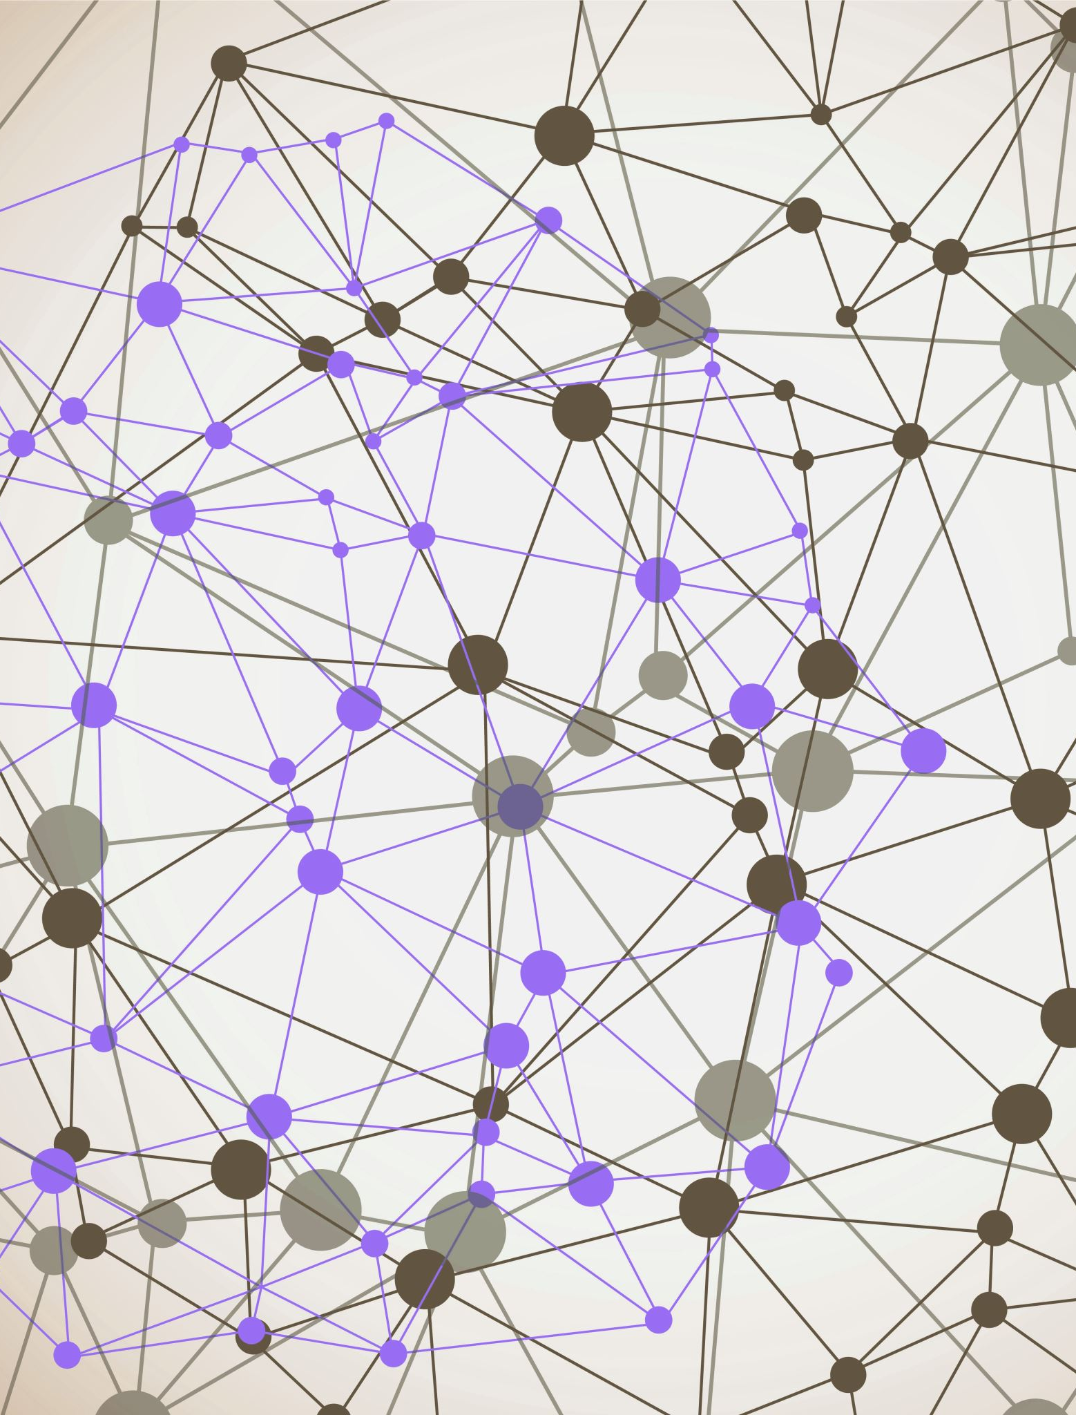
Deepfake Detection System Using Deep Learning
Project mentor : Mr. Arnav Kotiyal (Assistant professor)
Submitted by : Aditya Semwal
University Roll no-2019528

Slide 2
Introduction

Slide 3
What is Deepfakes?
A deepfake is a type of fake media created using artificial intelligence to make it look and sound like someone is doing or saying something they never actually did. This technology can convincingly alter videos, photos, or audio to fabricate events, often making it hard to tell what's real. While deepfakes can be fun for entertainment, they also pose serious risks, such as spreading false information or damaging someone's reputation

Slide 4
Risks and Concerns
Misinformation: Can be used to spread false information, impacting politics and public opinion.
Privacy Violations: Creating unauthorized content involving individuals without their consent.
Fraud and Identity Theft: Used in scams or impersonations to deceive others.
Reputation Damage: Targeting individuals or organizations with false content to harm their reputation.

Slide 5
How Deep Learning helps in Deepfake Detection
Convolutional Neural Networks (CNNs) help in detecting deepfakes by analyzing images and videos for subtle inconsistencies that are hard for humans to spot. CNNs can be trained on large datasets of real and fake media to learn patterns and features that differentiate genuine content from deepfakes. They excel at identifying minute details, such as unnatural facial movements, irregular lighting, or pixel anomalies, which indicate tampering. By processing this information, CNN-based deepfake detection systems can accurately flag altered or synthetic content, helping to combat misinformation and protect against fraud.

Slide 6
Methodology

Slide 7

Initialization phase

Slide 8
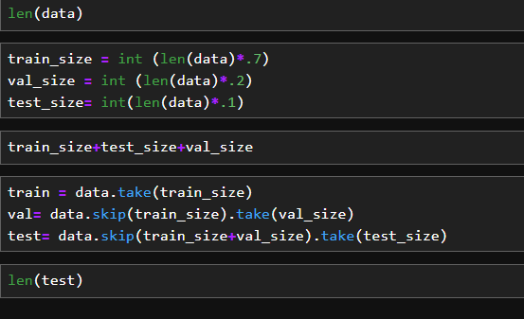
Splitting dataset phase

Slide 9
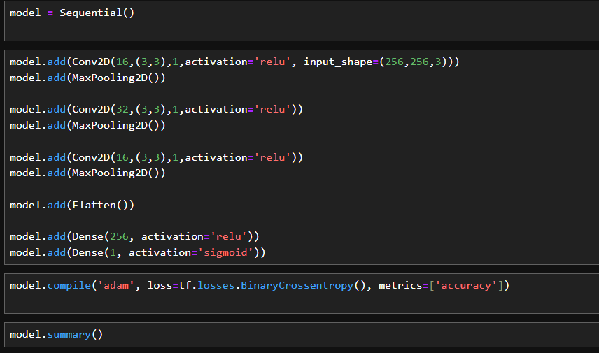
CNN Model development phase

Slide 10
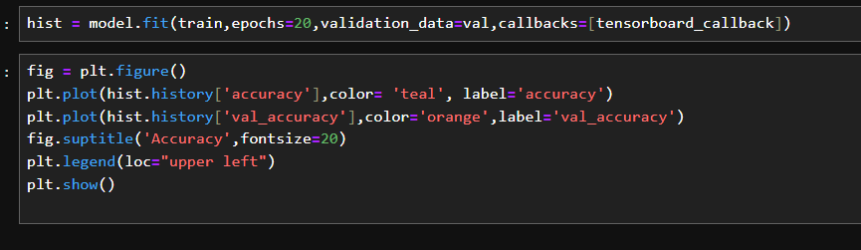
Training Phase and Accuracy of model

Slide 11
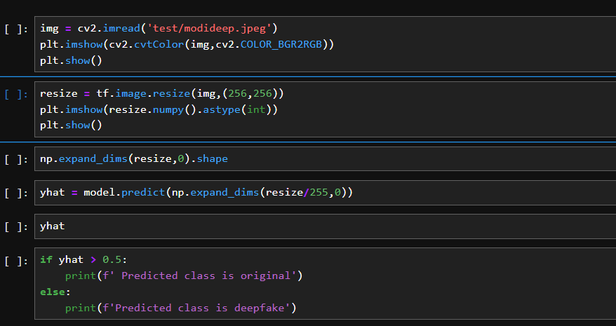
Testing phase

Slide 12
Result

Slide 13

Final Output

Slide 14
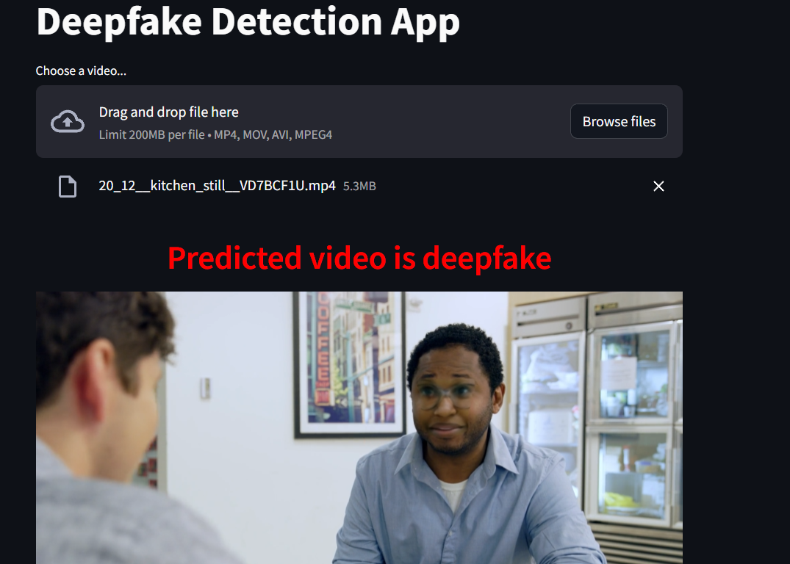
Final Output

Slide 15
Conclusion
Deep learning can be an effective tool for Deepfake Detection system. Overall Deepfake detection techniques can achieve high accuracy rates and can be scalable.
Proper technique should be used on a given dataset to achieve high accuracy.

